Slide 1
Maybe Deep Neural Networks are the Best Choice for Modeling Source Code
Under review at ICSE 2020
Liu Fang
2019-12-04

Slide 2
Introduction
Much of software is natural, that is, because software is written for humans to read, it displays some of the same statistical properties as natural language. There is now a large literature on language modeling for code.
There is a key general challenge in deep learning models of code, which significantly hinders their usefulness —— out of vocabulary (OOV) problem, which is that new identifier names are continuously invented by developers.
Hellendoorn and Devanbu [1] present a n-gram LM with several code-specific extensions. This enhanced n-gram model shows improved performance over an off-the-shelf neural language model for code and raise the provocative suggestion that deep models might not be the best choice for modeling source code.
[1] Vincent J. Hellendoorn and Premkumar Devanbu. 2017. Are Deep Neural Networks the Best Choice for Modeling Source Code? (ESEC/FSE2017)

Slide 3
Introduction
We argue that to the contrary, perhaps deep networks are a good choice for modeling source code, because it is possible to overcome the limitations highlighted by [1]
We address the key challenge of deep models of source code that was highlighted in the previous work, namely, the OOV problem, by introducing an open-vocabulary neural language model for source code.
Our open vocabulary model is based on the idea of subword units, which are a way of combining the strengths of character-level and token-level models
[1] Vincent J. Hellendoorn and Premkumar Devanbu. 2017. Are Deep Neural Networks the Best Choice for Modeling Source Code? (ESEC/FSE2017)

Slide 4
Out-of-vocabulary Problem
Traditional LMs are closed vocabulary, and they are unable to predict OOV words, which is an obvious issue for code.
Many identifiers appearing in the training set are rare. This sparsity could potentially confuse the model or result in slower estimation of parameters.
Previous Research
Segmented identifiers via a heuristic [1]: splits them on camel case and underscores.
only combinations of subtokens appearing in the training set and thus unable to achieve an open vocabulary
many of these subtokens are still infrequent, which hinders the model’s ability to assign high scores to their compositions.
Automatically split identifiers into sequences of words by mining word frequencies in source code [2].
focuses on splitting identifiers into words in a way that matches human judgements.
in our application, it is of no interest whether our subword units correspond to words that humans recognize.
[1] Miltiadis Allamanis, Earl T. Barr, Christian Bird, and Charles Sutton. 2015. Suggesting Accurate Method and Class Names. (ESEC/FSE 2015)
[2] Enslen, Eric, et al. "Mining source code to automatically split identifiers for software analysis." (MSR 2009)
Notes:
our goal is to split identifiers in a way that improves a language model; in many cases, our subword units will be sequences of characters that are not words.
our subword units can be trivially reassembled into complete tokens before they are shown to a developer.

Slide 5
Methodology
Neural Language Model with GRU Cell
A single layer GRU NLM built upon subword units which have been learned from BPE
Hidden size: 512
Embedding size: 512
Learning rate: 0.1
Dropout: 0.5
Unroll the GRU for 200 timesteps

Slide 6
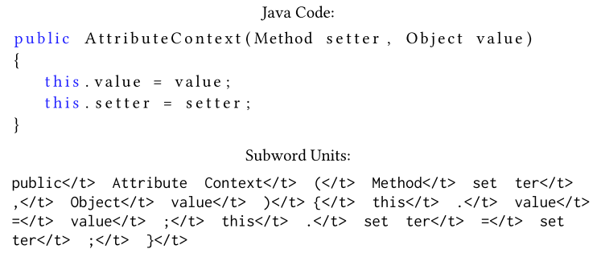
Methodology
Selecting Subword Units Using Byte Pair Encoding
Address the OOV problem by having the model predict subword units rather than full tokens at each time step of the RNN.
A subword unit is an n-gram of characters that appear as a subsequence of some token in the corpus.

Slide 7
Methodology
Selecting Subword Units Using Byte Pair Encoding
The use of a subword unit LM for code has two potential advantages.
Smaller vocabulary size: it may have better performance because of a reduced level of data sparsity.
Model can synthesize OOV tokens that have not been seen in the training data via the smaller subtoken units.

Slide 8
Methodology
Selecting Subword Units Using Byte Pair Encoding
Byte Pair Encoding (BPE) is a data compression algorithm that iteratively finds the most frequent pair of bytes in the vocabulary appearing in a given sequence, and then replaces it with a new unused entry.
characters or character sequences.
Initialize: initialize the symbol vocabulary with the character vocabulary, and represent each word as a sequence of characters, plus a special end-of-token symbol </t>.
Merge operation: count all symbol pairs appearing in the vocabulary and then replace all the appearances of the most frequent pair (S1, S2) with a unique new single symbol S1S2, which we also add to the vocabulary.
Stop: The algorithm stops after a given maximum number of merge operations to be performed is reached.
New vocabulary: contains all the initial characters plus the symbols created from the merge operations.
Notes:
do not consider merging pairs that cross token boundaries

Slide 9
Methodology
Selecting Subword Units Using Byte Pair Encoding
{'l o w </w>': 5, 'l o w e r </w>': 2, 'n e w e s t </w>': 6, 'w i d e s t </w>': 3}
byte pair “e” and “s” occurred 6 + 3 = 9 times which is the most frequent. We merge these to into a new token “es”.
{'l o w </w>': 5, 'l o w e r </w>': 2, 'n e w es t </w>': 6, 'w i d es t </w>': 3}
token “es” and “t” occurred 6 + 3 = 9 times, which is the most frequent. We merge these to into a new token “est”.
{'l o w </w>': 5, 'l o w e r </w>': 2, 'n e w es t </w>': 6, 'w i d es t </w>': 3}
Merge “est” and “</w>”
…

Slide 10
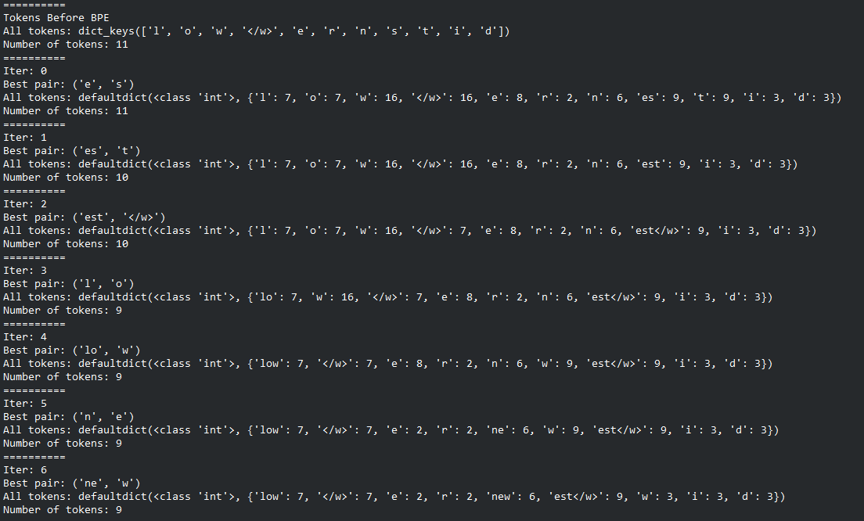
Methodology
Selecting Subword Units Using Byte Pair Encoding

Slide 11
Methodology
Selecting Subword Units Using Byte Pair Encoding
Build vocabulary
Run the BPE algorithm on a held out dataset of projects that are separate from the training, validation, and test sets.
Train LM
Segment the train, validation, and test sets using the learned encoding.
To do this, we transform each token into a sequence of its characters, adding </t> symbols after every token.
Then we apply in order the merge operations from BPE tomerge the characters into subword units in the vocabulary.
Train and test a GRU LM in the usual way on the data that has been segmented into subword units.
Notes:
Experimented with three different encoding sizes, i.e., the maximum number of merge operations: 2000, 5000, and 10000 operations

Slide 12
Methodology
Predicting Best k Tokens
The model is based on subword units, it is not completely trivial to generate top k predictions of full tokens, because a single token could be made from many subword units.
Using a beam-search-like algorithm.
A complete token is a sequence of subword units $w_{1} …w_{M}$ that comprise exactly one token: that is, $w_{M}$ ends with </t> and none of the earlier subword units do.
The goal of the search algorithm is to find the k highest probability complete tokens.

Slide 13
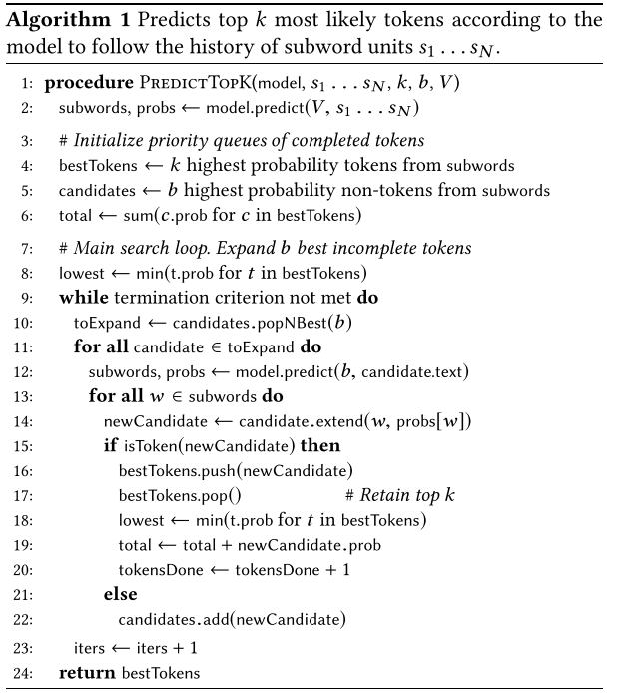
Methodology
Predicting Best k Tokens
two priority queues:
Candidates: ranks the sequences of subword units that still need to be explored during the search
bestTokens: contains the k highest probability complete tokens that have been expanded so far.
Notes:
given a history s1 . . . sN of subword units that already appear in a source file, predict the complete token that is most likely to occur next

Slide 14
Methodology
Predicting Best k Tokens
Termination criteria
(a) The number of complete tokens that have been explored during the search exceeds a threshold (tokensDone > 5000).
(b) The cumulative probability of all the tokens that have been explored exceeds the threshold, i.e. total > 0.8
(c) A sufficient number of search iterations have been completed, i.e. iters > 7.
(d) The probability of the best candidate is less than the worst current complete top-k tokens, that is, min{c.prob | c ∈ bestTokens} ≥ max{c.prob | c ∈ candidates)}.
Notes:
given a history s1 . . . sN of subword units that already appear in a source file, predict the complete token that is most likely to occur next
This search procedure is repeated until any of the following termination criteria has been satisfied at line 9.
Expanding a candidate cannot increase its probability, so at this point we are guaranteed that no better complete tokens will be found in the remainder of the search.
These criteria ensure that the beam search always terminates

Slide 15
Methodology
Dynamic adaptation to new projects
It is important to be able to quickly adapt a global LM, which has been trained on a diverse corpus of projects, to have better performance on a new project of interest.
Given a new project, we start with the global LM and update the model parameters by taking a single gradient step on each encountered sequence in the project after testing on it.
Unroll the GRU for 20 time steps instead of 200 as in our global models, in order to update the parameters more frequently.

Slide 16
Datasets
Three popular programming languages: Java[1], C[2], and Python[3]
For Java we used the Java Github corpus of Allamanis et al. [1], which consists of more than 14000 popular open source Java projects.
The C corpus was mined in [2]
Python corpus was mined in [3].
For Python and C:
Sampled 1% of the corpus for validation, 1% for testing, another 10% was sampled for learning BPE subword encoding.
The rest of the data was used for training.
A smaller subset of 2% of our full training set.
[1] Miltiadis Allamanis and Charles Sutton. 2013. Mining Source Code Repositories at Massive Scale Using Language Modeling. (MSR 13)
[2] Sergey Dudoladov. 2013. Statistical NLP for computer program source code: An information theoretic perspective on programming lanuguage verbosity. Master’s thesis. School of Informatics, University of Edinburgh, United Kingdom
[3] Stefan Fiott. 2015. An Investigation of Statistical Language Modelling of Different Programming Language Types Using Large Corpora. Master’s thesis. School of Informatics, University of Edinburgh, United Kingdom
[4] Vincent J. Hellendoorn and Premkumar Devanbu. 2017. Are Deep Neural Net- works the Best Choice for Modeling Source Code? (ESEC/FSE2017)

Slide 17
Datasets
Three popular programming languages: Java[1], C[2], and Python[3]
For Java we used the Java Github corpus of Allamanis et al. [1], which consists of more than 14000 popular open source Java projects.
The C corpus was mined in [2]
Python corpus was mined in [3].
For Java:
validation and test sets are the same as in [4], and our “small train” set is the same as their training set.
to obtain the full Java train set, we collect all of the files in the Java Github corpus that do not occur in the validation or test set.
sampled 1000 random projects for the subword encoding data set, and the remaining projects were used as the full train set.
[1] Miltiadis Allamanis and Charles Sutton. 2013. Mining Source Code Repositories at Massive Scale Using Language Modeling. (MSR 13)
[2] Sergey Dudoladov. 2013. Statistical NLP for computer program source code: An information theoretic perspective on programming lanuguage verbosity. Master’s thesis. School of Informatics, University of Edinburgh, United Kingdom
[3] Stefan Fiott. 2015. An Investigation of Statistical Language Modelling of Different Programming Language Types Using Large Corpora. Master’s thesis. School of Informatics, University of Edinburgh, United Kingdom
[4] Vincent J. Hellendoorn and Premkumar Devanbu. 2017. Are Deep Neural Net- works the Best Choice for Modeling Source Code? (ESEC/FSE2017)

Slide 18
Evaluation
Metrics
Cross Entropy and MRR
Test Scenarios
Static tests: The model is first trained on a fixed training corpus, and is later evaluated on a separate test dataset.
Dynamic tests: The model is allowed to update its parameters after it has made predictions on files in the test set.
Software Maintenance tests: the LMs are tested on one file at a time in the test set. For each file, the full training set plus all other files in the test project apart from the file of interest is used as training data.
Notes:
requires retraining the model once for each file in the test set, this scenario was previously deemed infeasible for NLMs

Slide 19
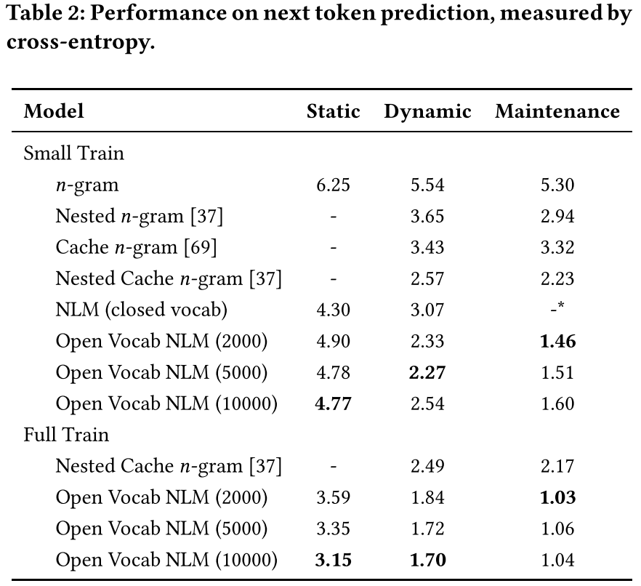
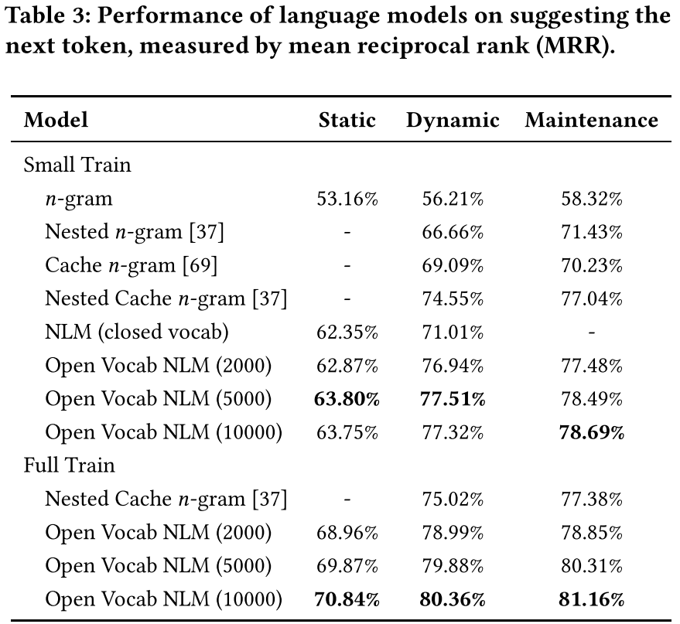
Evaluation
RQ1. How does the performance of subunit neural LMs compare to state-of-the-art LMs for code?
Notes:
we cannot report results for the nested or cache n-gram models on the static setting because these models make use of information from the test.
do not report results from the closed vocabulary NLM on the maintenance setting due to the massive time and space requirements of this experiment.
even when trained on a relatively small corpus, open vocabulary NLMs are effective models of code

Slide 20
Evaluation
RQ2. Are subword unit NLMs effectively trainable on large code corpora, such as giga-token corpora? Does the additional training data yield significant performance improvements?
Notes:
trained on larger corpora the performance of n-gram models gets saturated and they are unable to effectively leverage the extra information
additional training data helps our NLM learn to synthesize identifiers from subword units better and with higher confidence.
improvements are smaller but still exist when the model is dynamically adapted on a test project.
subword unit NLMs can utilize a large code corpus better than n-gram models.

Slide 21
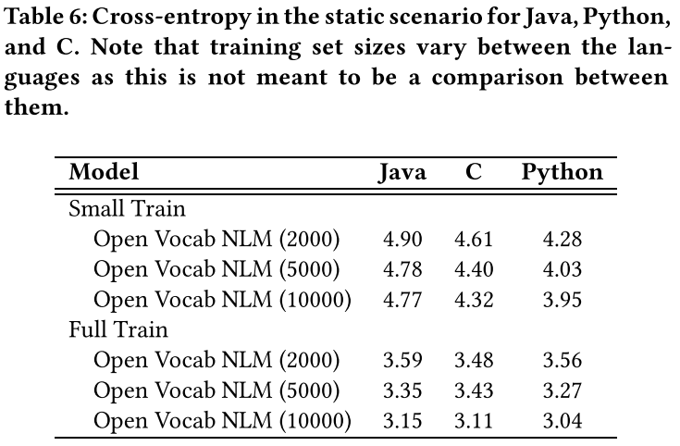
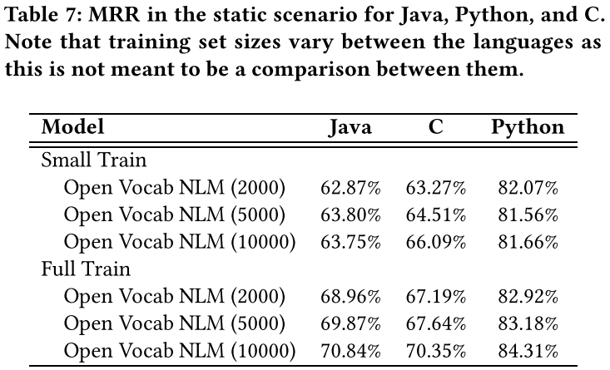
Evaluation
RQ3. How does the performance of subword unit NLMs vary across programming languages?
Notes:
performance on C and Python is at least as good as Java, providing evidence that our methodology for training subword unit NLMs is indeed language agnostic

Slide 22
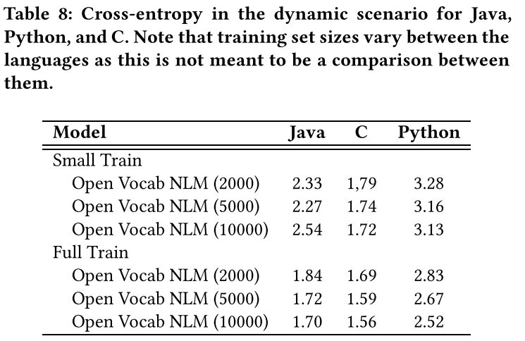
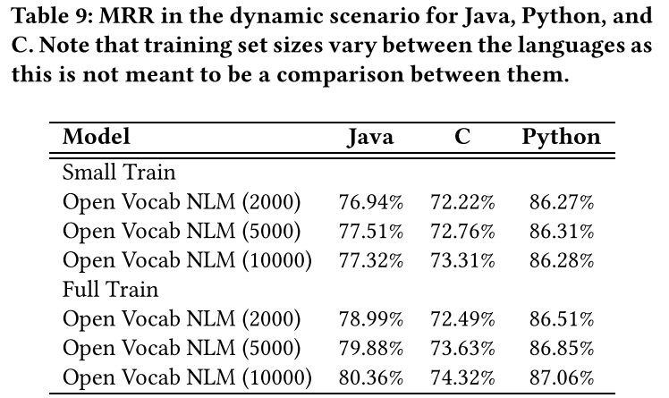
Evaluation
RQ3. How does the performance of subword unit NLMs vary across programming languages?

Slide 23
Evaluation
RQ4. Is the dynamic updating procedure effective at dynamically updating subword unit NLMs to new projects?
Notes:
all of the advanced n-gram models in the dynamic and maintenance settings perform better than any of the NLM models in the static setting, result holds both for the small train set and for the full train set.
the improvement due to dynamic adaptation is greater than the improvement due to an NLM, our dynamic adaptation method is indeed effective at fine-tuning a global sub-word unit NLM to a specific test project

Slide 24
Conclusions
Presented a new open-vocabulary neural language model for source code.
By defining the model on subword units, the model is able to handle neologisms, while keeping the size of the model relatively small.
the general technique of using subword units is not limited to language modeling, but can easily be incorporated into many neural models of code tokens. This idea could have broad application throughout software engineering:
suggest readable function and class names
summarizing source code
predicting bugs
detecting code clones
…

Slide 25
Conclusions
Limitations:
Token segmentation granularity
The cost of beam search
Base model is weak

Slide 26
Thanks

